Slide 1
Software Requirement Engineering
CSE-305
Dr Ghulam Rasool

Slide 2
Requirement Engineering Processes(Outline)
We will discuss the notion of processes and process models for requirements engineering
Requirement Engineering process models
The role of people in requirements engineering processes
To explain why process improvement is important

Slide 3
Process
A process is an organized set of activities, which transforms inputs to outputs
Processes are essential for dealing with complexity in real world
Processes document the steps in solving a certain problem
Processes require creativity, background knowledge and interaction b/w different range of people
They allow knowledge to be reused
Examples:
An instruction manual for assembling a computer or its parts
A procedure manual for operating a motor vehicle radio and CD player
A quality manual for software development.
A manual for assembling Microwave oven

Slide 4
Software Process
Software processes help in performing different software engineering activities in an organized manner
Examples:
Software engineering development process (SDLC)
Requirements engineering process
Design process
Quality assurance process
Change management process

Slide 5
Requirement Engineering Processes
The process(es) involved in developing system requirements is collectively known as Requirements Engineering Process
Requirements engineering is the process, which enables us to systematically determine the requirements for a software product
Requirements engineering processes are dominated by human, social and organizational factors
Based on the need of individual software projects and organizational needs, requirements engineering processes are tailored
An important point to remember is that “There is no ideal requirements engineering process”

Slide 6
Inputs and outputs for RE
Existing
systems
information
Stakeholder
needs
Agreed
requirements
Requirements
Engineering Process
Organizational
standards
System
specification
System
models
Regulations
Domain
information

Slide 7
RE Process – Inputs
Existing system information
Information about the functionality of systems to be replaced
Information about other systems, which interact with the system being specified
Stakeholder needs
Description of what system stakeholders need from the system to support their work
Organizational standards
Standards used in an organization regarding system development practice, quality management, etc.

Slide 8
RE Process – Inputs
Regulations
External regulations such as health and safety regulations, which apply to the system
Domain information
General information about the application domain of the system

Slide 9
RE Process – Inputs/Outputs
Agreed requirements
A description of the system requirements, which are understandable by stakeholders and which has been agreed by them
System specification
This is a more detailed specification of the system, which may be produced in some cases
System models
A set of models such as a data-flow model, an object model, a process model, etc., which describes the system from different perspectives

Slide 10
Important Tasks for RE Process
There are two main tasks which needs to be performed in the requirements engineering process.
Problem analysis
Analysis of a software problem
Product description
Complete specification of the desired external behavior of the software system to be built. Also known as functional description, functional requirements, or specifications

Slide 11
What is the requirements engineering process?
The processes used for requirements engineering vary widely depending on the application domain, the people involved and the organization developing the requirements
Due to diversity of different software projects and organizational cultures, there is no single, formulaic approach to requirement development
Generally, RE processes follow these activities:
Requirements elicitation
Requirements analysis
Requirements specification
Requirements validation
Requirements management

Slide 12
RE Process Activities
Requirements Elicitation
Define requirement development process
Requirements acquisition or requirements discovery through consultation with stakeholders, from system documents, domain knowledge, and market studies
Requirement Discovery using different elicitation techniques
Requirements Analysis
Understanding the relationships among various customer requirements and shaping those relationships to achieve a successful result
Incomplete and inconsistent information needs to be tackled here
Modeling requirements using different diagrams
Requirements Specification
Building a tangible model of requirements using natural language and diagrams
Building a representation of requirements that can be assessed for correctness, completeness, and consistency
Adopt SRS Template

Slide 13
RE Process Activities
Requirements Validation
It involves reviewing the requirements model for consistency and completeness
This process is intended to detect problems in the requirements document, before they are used as a basis for the system development
Reviews and Inspections are used for validation
Requirements Management
It is performed throughout requirement engineering activities
Requirements management asks to identify, control and track requirements and the changes that will be made to them
Baseline and control versions of requirements

Slide 14
Benefits of high quality requirement process
Fewer requirements defects
Better control of complex projects
Reduced development rework
Faster development
Lower enhancement costs
Fewer misconceptions
Reduced project chaos
Higher customer and team member satisfaction

Slide 15
RE Process Models
A process model is a simplified description of a process presented from a particular perspective
There may be several different models of the same process
Types of Process Models for RE
Coarse-grain activity model(Linear RE Model)
Linear Iterative Model
Spiral Model(Iterative)
Role-action model
V Model

Slide 16
Coarse-grain Activity Model(Linear RE Model)
Requirements
Analysis and
Negotiation
Requirements
Elicitation
Requirements
Specification
Requirements
Validation
User Needs,
Domain Information,
Existing System
Information, Regulations,
Standards, Etc.
Requirements
Document
Agreed
Requirements

Slide 17
Coarse-grain Activity Model
This type of model provides an overall picture of the process and provide foundation for other models
Describes the context of different activities in the process
Problems in this model are:
No user feedback
No Freezing of requirements
No risk management

Slide 18
Linear Iterative RE Model
It follows iterations for validation of requirements again and again until stakeholders are agreed and final system specification is achieved
It solves some problems of Linear RE model such as freezing of requirements and requirement invalidation but it has no strategy for risk management

Slide 19
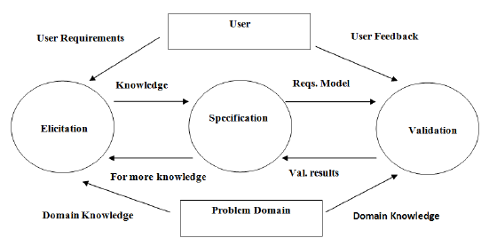
Linear Iterative RE Model

Slide 20
Spiral Model for RE
The key motivation for spiral model is the risk analysis and risk management
Requirements are discovered in different iterations and can be re-evaluated after each spiral

Slide 21
Spiral Model for RE
Informal statement of
requirements
Requirement
elicitation
Requirement analysis
and negotiation
Requirements
document and
validation report
Agreed
requirements
START
Requirement
documentation
Requirement
validation
Draft requirements
document

Slide 22
Role-action Models
These are models, which show the roles of different people involved in the process and the actions which they take
They are useful for process understanding and automation
Example: Stakeholders model for organization

Slide 23
Role-Action Diagram for Software Prototyping
ACTIONS
Establish
outline
requirements
Select
prototyping
system
Understand
problem
Develop
prototype
Evaluate
prototype
Req. Engineer
Domain expert
End-user
End-user
Domain expert
Req. Engineer
SW Engineer
Req. Engineer
End-user
SW Engineer
Project Mgr
Req. Engineer
SW Engineer
ROLES

Slide 24
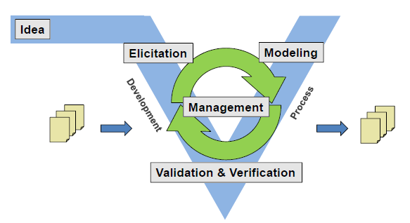
V Model

Slide 25
RE Process Variability
RE processes vary radically from one organization to another, and even within an organization in different projects
Unstructured processes rely heavily on the experience of the people, while systematic processes are based on application of some analysis methodology, but they still require human judgment

Slide 26
Variability Factors
There are four factors which count towards the variability of the Requirements Engineering Process
Technical maturity
Disciplinary involvement
Organizational culture
Application domain

Slide 27
Variability Factors
Technical maturity
The technologies and methods used for requirements engineering vary from one organization to other
Disciplinary involvement
The types of engineering and managerial disciplines involved in requirements vary from one organization to another
Organizational culture
The culture of an organization has important effect on all business and technical processes
Application domain
Different types of application systems need different types of requirements engineering process

Slide 28
RE Process Support
One way to minimize errors in the requirements engineering is to use process models and to use CASE tools
The most mature CASE tools support well-understood activities such as programming and testing and the use of structured methods
Support for requirements engineering is still limited because of the informality and the variability of the process

Slide 29
RE Process Qualities
Process is reliable if it consistently leads to high-quality products
Process is robust if it can accommodate unanticipated changes in tools and environments
Process performance is productivity
Process is evolvable if it can accommodate new management and organizational techniques
Process is reusable if it can be applied across projects and organizations

Slide 30
CASE Tools for RE
Modeling and validation tools support the development of system models which can be used to specify the system and the checking of these models for completeness and consistency
Management tools help manage a database of requirements and support the management of changes to these requirements
Tools provide amount of information about requirements relationships that are maintained

Slide 31
CASE Tools for RE
Requirement browsers
Traceability support system
Requirement query systems
Report generators
Change control systems
Requirement converters etc.

Slide 32
Process Improvement
Process improvement is concerned with modifying processes in order to meet some improvement objectives
Improvement objectives includes:
Quality improvement
Schedule reduction
Resource reduction

Slide 33
Planning Process Improvement
Some important questions arise:
What are the problems with current processes?
What are the improvement goals?
How can process improvement be introduced to achieve these goals?
How should process improvements be controlled and managed?

Slide 34
RE Process Problems
Lack of stakeholder involvement
Business needs not considered
Lack of requirements management
Lack of defined responsibilities
Stakeholder communication problems
Gold-plating
Over-long schedules and poor quality requirements documents

Slide 35
Process Maturity
Process maturity can be thought of as the extent that an organization has defined its processes, actively controls these processes and provides systematic human and computer-based support for them
The SEI’s Capability Maturity Model is a framework for assessing software process maturity in development organizations

Slide 36
RE Process Maturity Model
– Verification
– Validation
– Organizational Process Focus
– Organizational Process Definition
– Organizational Training
– Risk Management
– Integrated Teaming
Defined
Defined process based on best practices
Process improvement in place
Repeatable
Standardized requirements engineering
Fewer requirements errors
Project Planning
– Project Monitoring and Control
– Supplier Agreement Management
– Measurement and Analysis
– Process and Product Quality
Assurance
– Configuration Management
Initial
Ad-hoc requirements engineering
Requirements errors are common

Slide 37
References and Reading Papers
Requirements Engineering: Processes and Techniques’ by G. Kotonya and I. Sommerville, John Wiley & Sons, 1998
Requirements Engineering Process Models in Practice
REQUIREMENTS ENGINEERING PROCESSES, TOOLS/TECHNOLOGIES, &METHODOLOGIES
An Effective Requirement Engineering Process Model for Software Development and Requirements Management
REQUIREMENTS ENGINEERING PROCESSES, TOOLS/TECHNOLOGIES, & METHODOLOGIES
Requirements Engineering Process Models in Practice
STAR: A CASE Tool for Requirement Engineering
Requirement Tools http://www.volere.co.uk/tools.htm

